Slide 1
Repetition structures
Zainab Shahzadi

Slide 2
Why Is Repetition Needed?
Repetition allows you to efficiently use variables
Can input, add, and average multiple numbers using a limited number of variables
For example, to add five numbers:
Declare a variable for each number, input the numbers and add the variables together
Create a loop that reads a number into a variable and adds it to a variable that contains the sum of the numbers

Slide 3
while Looping (Repetition) Structure
The general form of the while statement is:
while is a reserved word
Statement can be simple or compound
Expression acts as a decision maker and is usually a logical expression
While is a pre-test loop
Statement is called the body of the loop
The parentheses are part of the syntax

Slide 4
while Loop Flow of Control

Slide 5
while Looping (Repetition) Structure (cont'd.)
Infinite loop: continues to execute endlessly
Avoided by including statements in loop body that assure exit condition is eventually false
false
condition
true
statement(s)

Slide 6
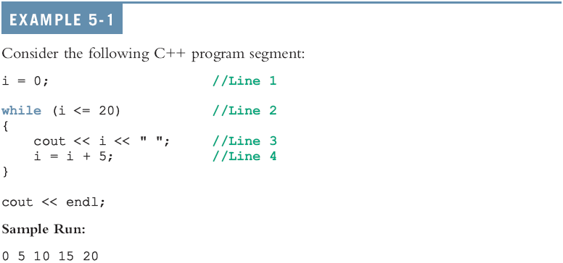
while Looping (Repetition) Structure (cont'd.)
Notes:
Note the expression for next example

Slide 7
Designing while Loops
Notes:
What if i=i+5 is ignored
Change the order of statements

Slide 8
Case 1: Counter-Controlled while Loops
If you know exactly how many pieces of data need to be read,
while loop becomes a counter-controlled loop with loop control variable (LCV)
Notes:
Print the numbers in ascending order.
Print numbers in descending order

Slide 9
User Controls the Loop Example
int num, limit;
cout << "Table of squares\n";
cout << "How high to go? ";
cin >> limit;
cout << "\n\nnumber square\n";
num = 1;
while (num <= limit)
{ cout << setw(5) << num << setw(6)
<< num*num << endl;
num++;
}
Notes:
See pr5-06.cpp

Slide 10
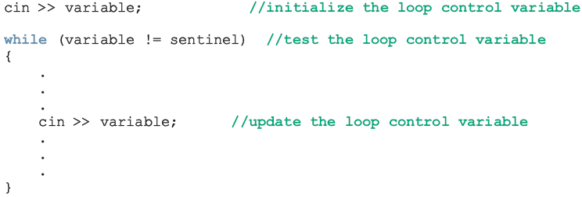
Case 2: Sentinel-Controlled while Loops
Sentinel variable is tested in the condition
Loop ends when sentinel is encountered

Slide 11
Sentinel Example
int total = 0;
cout << "Enter points earned "
<< "(or -1 to quit): ";
cin >> points;
while (points != -1) // -1 is the sentinel
{
total += points;
cout << "Enter points earned: ";
cin >> points;
}
Notes:
See pr5-11.cpp

Slide 12
Case 3: Flag-Controlled while Loops
A flag-controlled while loop uses a bool variable to control the loop
The flag-controlled while loop takes the form:

Slide 13
More on Expressions in while Statements
The expression in a while statement can be complex
For example:
while ((noOfGuesses < 5) && (!isGuessed))
{
…
}

Slide 14
for Looping (Repetition) Structure
The general form of the for statement is:
The initial statement, loop condition, and update statement are called for loop control statements
initial statement usually initializes a variable (called the for loop control, or for indexed, variable)
In C++, for is a reserved word

Slide 15
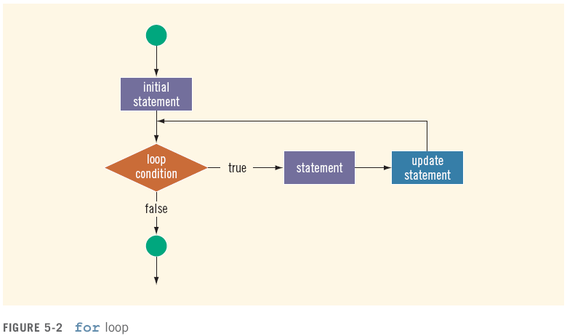
for Looping (Repetition) Structure (cont'd.)

Slide 16
for Loop Example
int sum = 0, num;
for (num = 1; num <= 10; num++)
sum += num;
cout << "Sum of numbers 1 – 10 is "
<< sum << endl;
Notes:
See pr5-09.cpp

Slide 17
for Loop Notes
If test is false the first time it is evaluated, the body of the loop will not be executed
The update expression can increment or decrement by any amount
Variables used in the initialization section should not be modified in the body of the loop

Slide 18
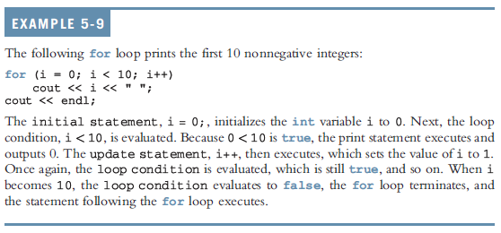
for Looping (Repetition) Structure (cont'd.)

Slide 19
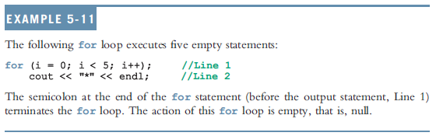
for Looping (Repetition) Structure (cont'd.)
C++ allows you to use fractional values for loop control variables of the double type
Results may differ
The following is a semantic error:
The following is a legal for loop:
for (;;)
cout << "Hello" << endl;

Slide 20
for Loop Modifications
Can define variables in initialization code
Their scope is the for loop
Initialization code, test, or update code can contain more than one statement
Separate statements with commas
Example:
for (int sum = 0, num = 1; num <= 10; num++)
sum += num;

Slide 21
More for Loop Modifications (These are NOT Recommended)
Can omit initialization if already done
int sum = 0, num = 1;
for (; num <= 10; num++)
sum += num;
Can omit update if done in loop
for (sum = 0, num = 1; num <= 10;)
sum += num++;
Can omit test – may cause an infinite loop
for (sum = 0, num = 1; ; num++)
sum += num;

Slide 22
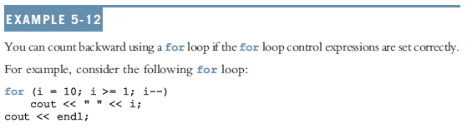
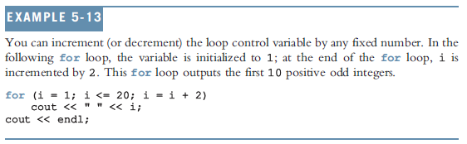
for Looping (Repetition) Structure (cont'd.)

Slide 23

do…while Looping (Repetition) Structure
General form of a do...while:
The statement executes first, and then the expression is evaluated
To avoid an infinite loop, body must contain a statement that makes the expression false
The statement can be simple or compound
This loop is post-test loop
Loop always iterates at least once

Slide 24
do…while Looping (Repetition) Structure (cont'd.)

Slide 25
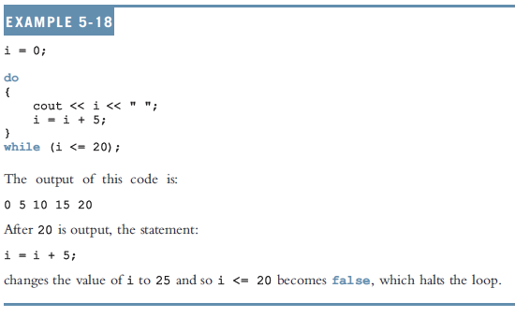
do…while Looping (Repetition) Structure (cont'd.)

Slide 26
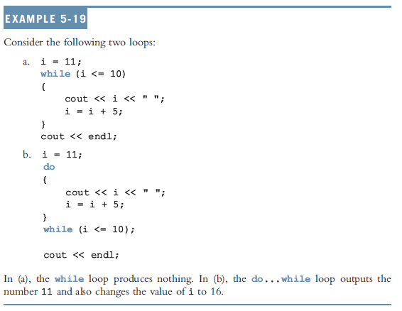
do…while Looping (Repetition) Structure (cont'd.)

Slide 27
Choosing the Right Looping Structure
All three loops have their place in C++
If you know or can determine in advance the number of repetitions needed, the for loop is the correct choice
If you do not know and cannot determine in advance the number of repetitions needed, and it could be zero, use a while loop
If you do not know and cannot determine in advance the number of repetitions needed, and it is at least one, use a do...while loop

Slide 28
break and continue Statements
break and continue alter the flow of control
break statement is used for two purposes:
To exit early from a loop
Can eliminate the use of certain (flag) variables
To skip the remainder of the switch structure
After the break statement executes, the program continues with the first statement after the structure

Slide 29
break and continue Statements (cont'd.)
continue is used in while, for, and do…while structures
When executed in a loop
It skips remaining statements and proceeds with the next iteration of the loop

Slide 30
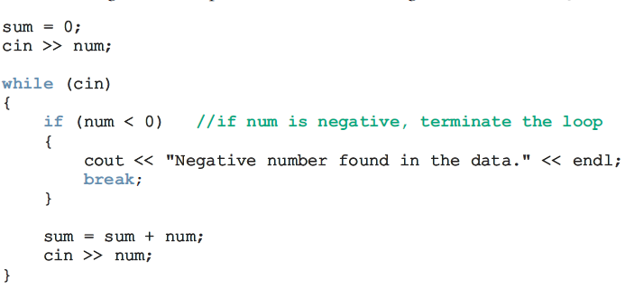
Break Statement Example

Slide 31
Continue Example
for (int i = 0; i < 100; ++i)
{
// Skip all the multiples of 7
// Operator % calculates the modulo (remainder)
// of a division; if (i % 7) is equal to zero
// this means that i is a multiple of 7.
if ((i % 7) == 0)
continue;
cout << i << " ";
}

Slide 32
Nested Control Structures (Nested Loops)
A nested loop is a loop inside the body of another loop
Example:
for (row = 1; row <= 3; row++)
{
for (col = 1; col <= 3; col++)
{
cout << row * col << endl;
}
}
outer loop
inner loop
Notes:
See pr5-14.cpp

Slide 33
Notes on Nested Loops
Inner loop goes through all its repetitions for each repetition of outer loop
Inner loop repetitions complete sooner than outer loop
Total number of repetitions for inner loop is product of number of repetitions of the two loops. In previous example, inner loop repeats 9 times

Slide 34
Output = ?
for (int y = 1; y <= 3; ++y) {
for (int x = 1; x <= 3; ++x) {
cout << x * y << " ";
}
cout << "\n";
}
Notes:
// 1 2 3
// 2 4 6
// 3 6 9

